Slide 1
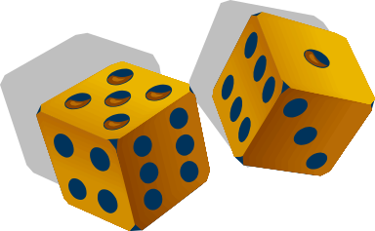
What are my Odds?
Historical and Modern Efforts to Win at Games of Chance

Slide 2
To Be Discussed
How gambling inspired the scientific study of probability
Three key mathematical concepts that emerged which describe the majority of gambling related phenomena.
Modern contributions of mathematicians to solving gambling problems.

Slide 3
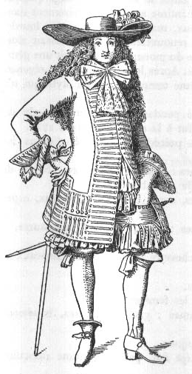
The 17th Century Gambler
In 1654, a well-known gambler, the Chevalier de Méré was perplexed by some seemingly inconsistent results in a popular game of chance.
Why, if it is profitable to wager that a 6 will appear within 4 rolls of one die, is it not then profitable to wager that double 6’s will appear within 24 rolls of two dice?
De Méré took his question to his Parisian friend Blaise Pascal.
The Chevalier de Méré
(as he might have looked)

Slide 4
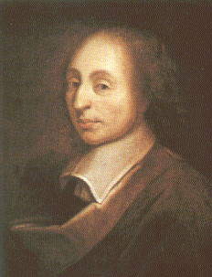
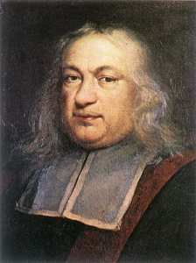
The Mathematicians
Stimulated by de Méré’s question, Pascal began a now famous chain of correspondence with fellow mathematician Pierre de Fermat.
It was evident that no existing theory adequately explained these phenomenon.
What resulted was the foundation on which the theory of probability rests today.
Blaise Pascal
Pierre de Fermat

Slide 5
Three Key Concepts
Probability
Mathematical Expectation
The Law of Large Numbers

Slide 6
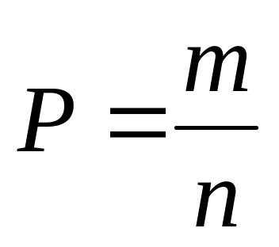
Probability (classical method)
Suppose that a game has n equally likely possible outcomes, of which m outcomes correspond to winning. Then the probability of winning is m/n

Slide 7
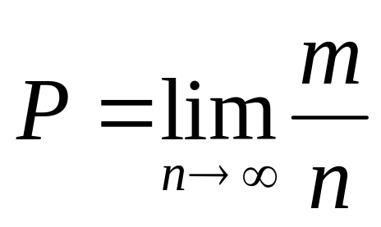
Probability (as limit of relative frequency)
If an experiment is performed whereby n trials of the experiment produce m occurrences of a a particular event, the ratio m/n is termed the relative frequency of the event.

Slide 8
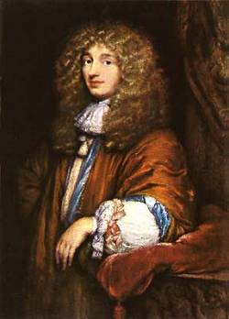
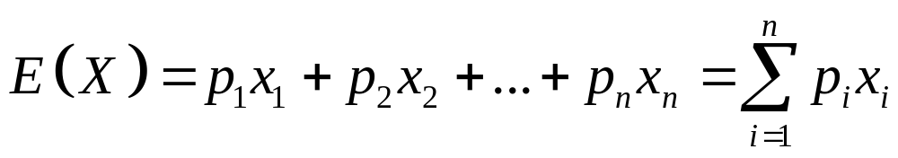
Mathematical Expectation
Idea first attributed to Dutch mathematician Christian Huygens
Defined as the weighted average of a random variable
Christian Huygens

Slide 9
Expectation of a wager
“The mathematical expectation of any bet in any game is computed by multiplying each possible gain or loss by the probability of that gain or loss, then adding the two figures.”
p (PROFIT) + (1-p) (LOSS) = E
Roulette:
(1/38) (35) + (37/38 ) (-1) = -.0526

Slide 10
Expectation is additive
Rule #1
“The only way to achieve a long term expected profit in gambling is to make net positive expectation bets.”

Slide 11
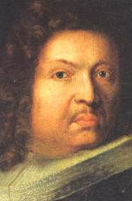
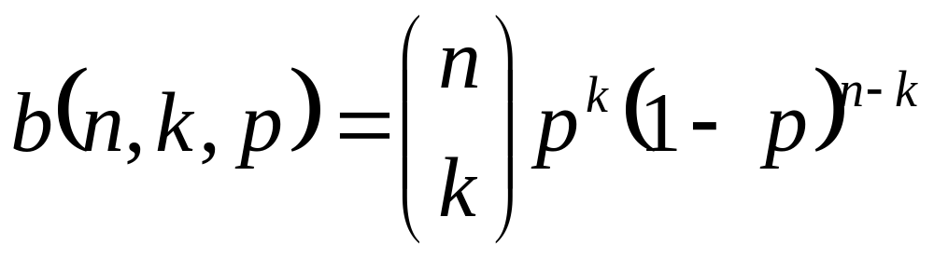
Law of Large Numbers
Gambling typically involves a series of repeated trials of a particular game.
Repeated independent trials in which there can be only two outcomes are called Bernoulli trials in honor of Jacob Bernoulli (1654-1705).
The binomial distribution:
Jacob Bernoulli

Slide 12
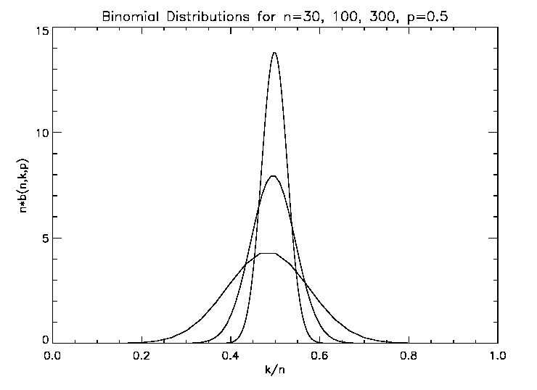
As the number of trials increases, the expected ratio of successes to trials converges stochastically to the expected result.

Slide 13
Tying the three concepts together
Being able to express the chance of an event as a probability allows the mathematical analysis of any wager.
The additive property of mathematical expectation enables the calculation of the overall expected result of a series of wagers.
The Law of Large Numbers guarantees that the actual result will converge stochastically towards the expected result.

Slide 14
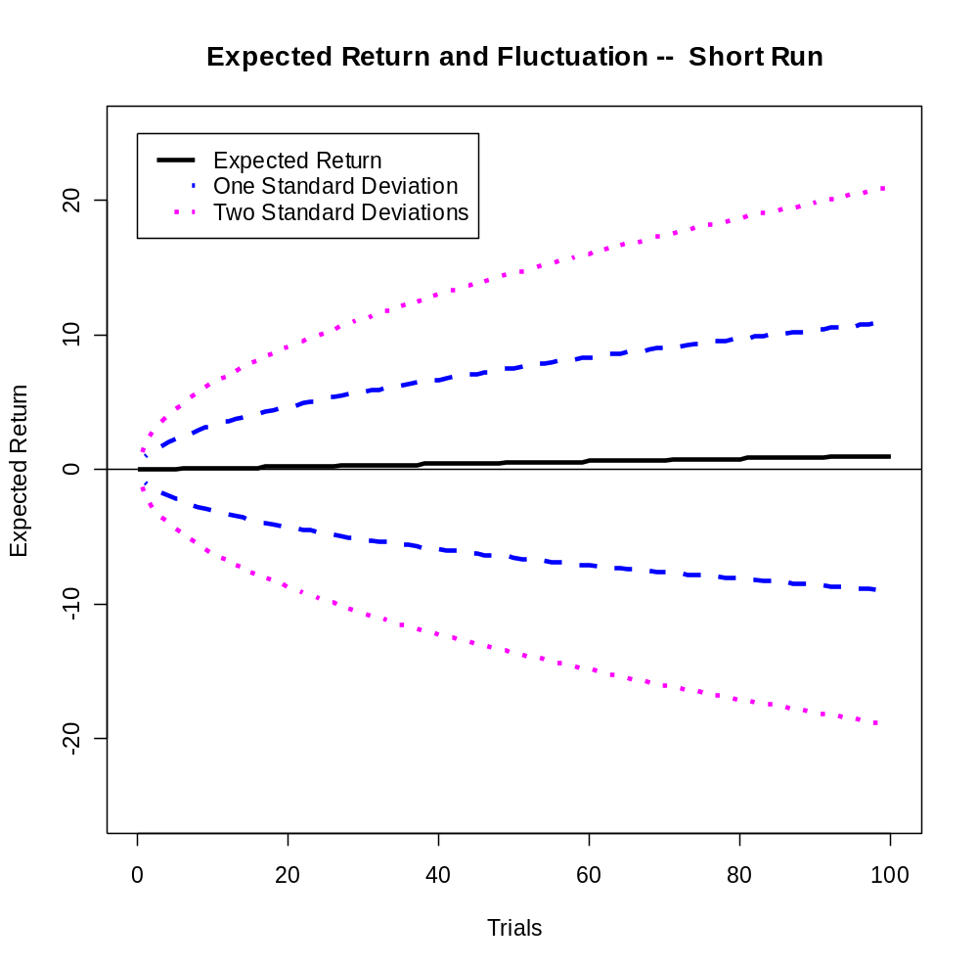

Slide 15
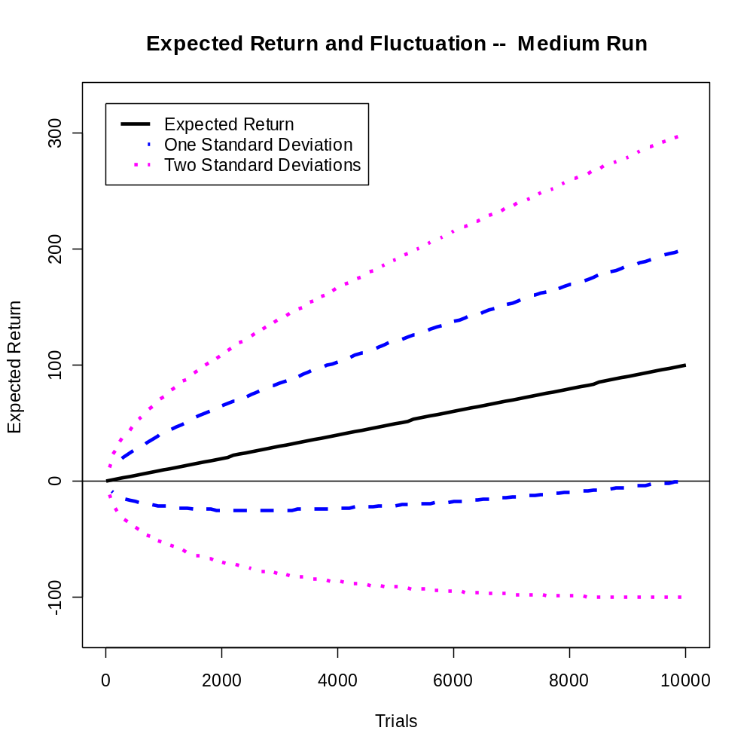

Slide 16
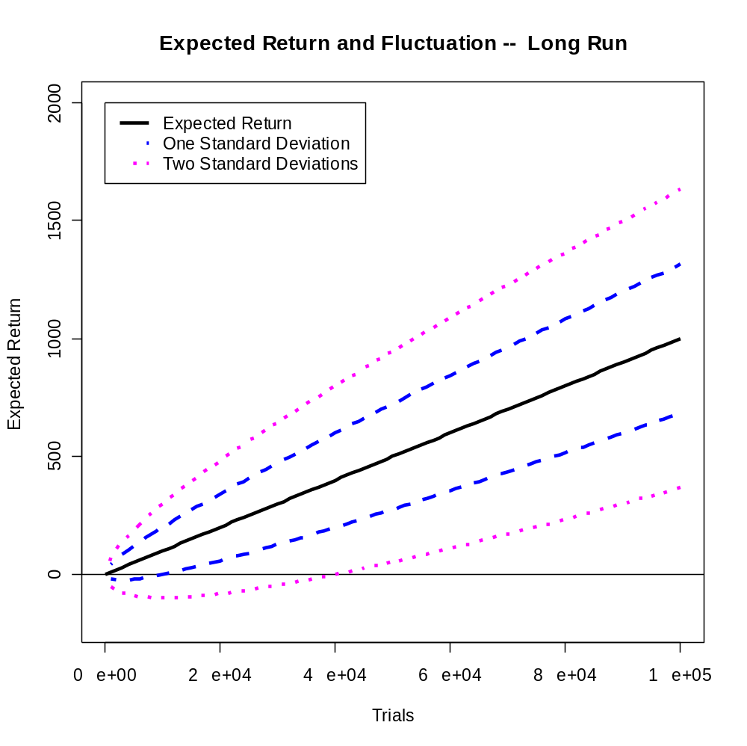

Slide 17
Modern Contributions
The basic problems were solved in the 17th century
However, occasional important new theoretical developments do occur.
Computer based mathematical techniques have been used to find winning systems in games that had previously seemed immune from such assaults.

Slide 18
The Kelly Criterion
Few purely “analytic” breakthroughs have been made in the last century. The Kelly Formula is an exception.
Working on the theory of information transmission at Bell Laboratories in the 1950’s, J.L. Kelly realizes that his findings could be applied to gambling.
He proposed a solution to the problem: “What fraction of his capital should a gambler risk on each play?”
The result has proven to be of general applicability and is widely used by modern professional gamblers.

Slide 19
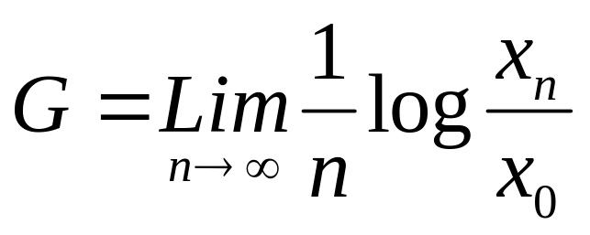
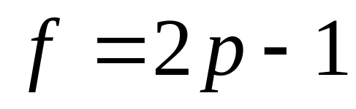
The Kelly Formula
The exponential rate of growth G of the bettor’s capital is given by
Where x₀ is the initial capital and x_{n} is the capital after n bets.
In a simple biased coin flipping game with even payoff and probability of winning p the optimal bet fraction is

Slide 20
Blackjack or “21”
The player initially receives two cards, and the dealer receives one card which is visible to the player.
The object of the game is to achieve a point total of your cards which is as close to 21 as possible without exceeding that number.
A game of both skill and chance.
Had been a popular casino game for 70 years.

Slide 21
Computer assisted analysis
The rules of blackjack are well defined and the game presented no theoretical challenge.
However, due to the large number of discrete “card-order dependencies”, the probability of winning could not be calculated manually.
Computer simulation was used to derive the optimal strategy and to determine the mathematical expectation.

Slide 22
Card Counting
In 1962 Professor Edward O. Thorp of the University of California published “Beat the Dealer”
For the first time, it was possible to use a mathematical strategy to achieve a positive expectation at a popular casino game.
This event ushered in the modern era of computer assisted “assaults” on games of chance.

Slide 23
Horse racing
Has inspired the most serious and sophisticated efforts to win.
In racing the challenge is to estimate each horse’s probability of winning.
Unlike well defined “idealized” games involving dice or cards, estimating probabilities in horse racing requires modeling real world phenomena.

Slide 24
Characteristics of the desired model
Combines heterogeneous variables into an overall predictor of horse performance
An estimate of each horse’s win probability is the desired output
The probability estimates should sum to 1 within each race
A way must exist to estimate the parameters of the model

Slide 25
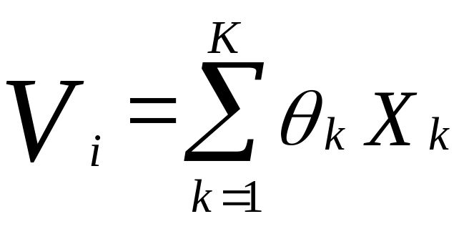
Expected Performance
Horse performance is the result of a number of variables:
V = θ₁ (avfin) + θ₂ (dayslst) + θ₃ (weight) + θ₄ (jckw%)….

Slide 26
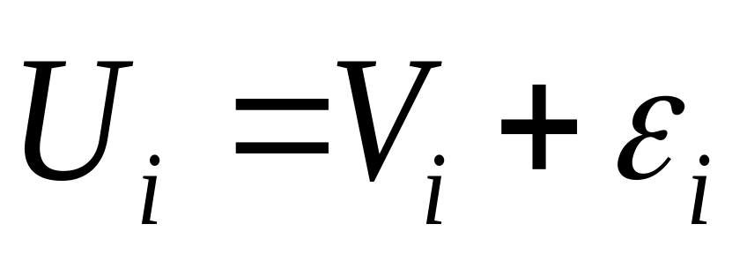
An actual horse performance
An actual performance is the result of the expected
performance plus some unknown random influences represented by ε
Assuming that ε is normally distributed results in a performance distribution which is normally distributed around a certain mean.

Slide 27
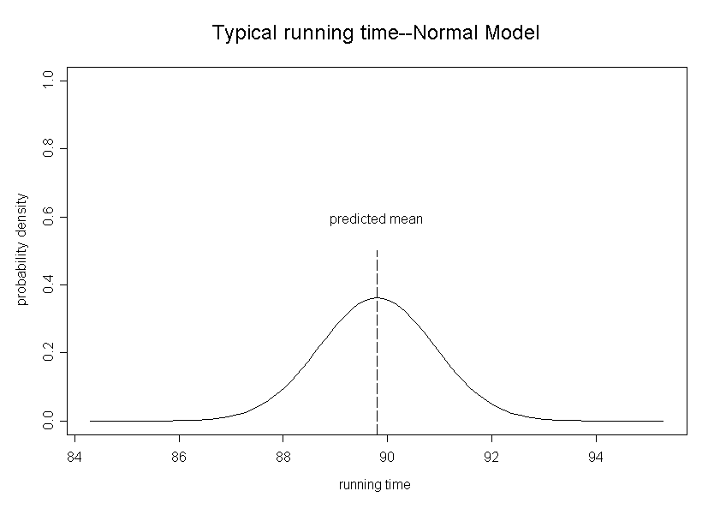
Performance with normal error

Slide 28
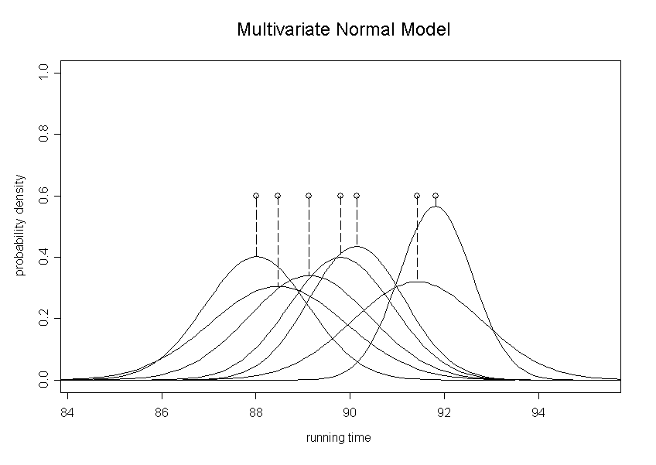
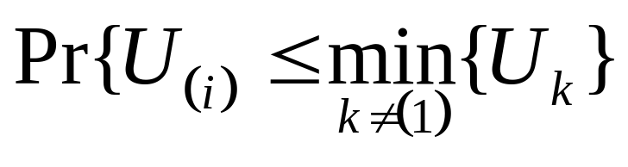
Joint performance distribution for a typical race

Slide 29
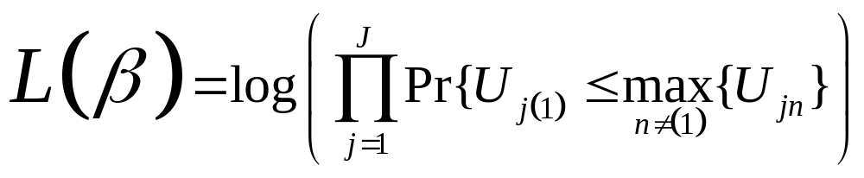
Parameter estimation
A likelihood function can be associated with a series of past horse races.
This function can be maximized with respect to the factor coefficients θ₁…..θ_{k} by stochastic approximation. ( Gu and Kong, 1998 )

Slide 30
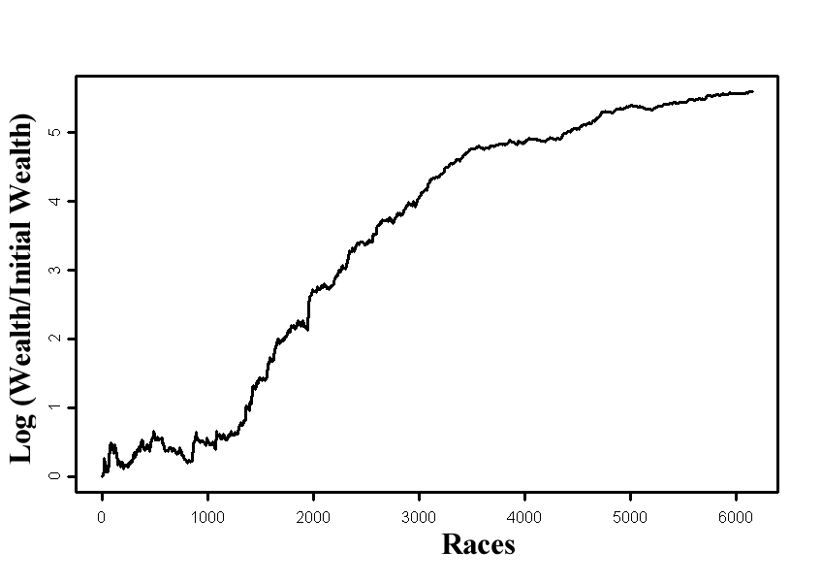
Cummulative Racing Results

Slide 31
“Gamblers can rightfully claim to be the godfathers of probability theory, since they are responsible for provoking the stimulating interplay of gambling and mathematics that provided the impetus to the study of probability”
– Richard Epstein

Slide 32
References
Benter, William F., “Computer Based Horse Race Handicapping and Wagering Systems”, Efficiency of Race Track Betting Markets, (San Diego CA: Academic Press, 1994)
Epstein, Richard A., Gambling and the Theory of Statistical Logic, revised edition, (New York, NY: Academic Press, 1977)
Gu, M. G. and Kong, F. H., A stochastic approximation algorithm with Markov chain Monte Carlo method for incomplete data estimation problems. (Proceedings of National Academic Science, 1998).
Thorp, Edward O., “Beat the Dealer” (New York, NY: Random House, 1962)

